Slide 1

AWS Machine Learning Terminology
Machine Learning Terminology Categories
Data Engineering
Data Analysis
Modeling
Algorithms
Implementation and Operations

Slide 2
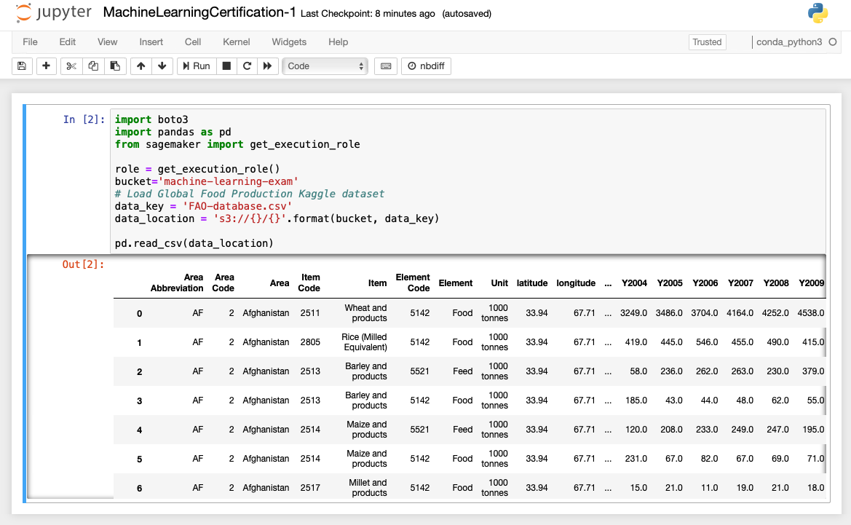
Data Engineering Terminology
Datasets
Datasets
A collection of data used as the “fuel” for our machine learning models

Slide 3
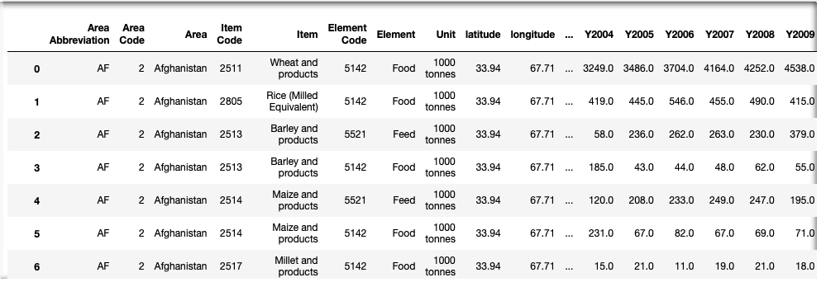
Data Engineering Terminology
Datasets
Dataset
= input data
= training/testing/validation data
Column
= attribute
= feature
Row
= observation
= sample
= data point

Slide 4
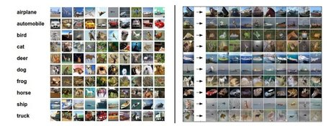
Data Engineering Terminology
Dataset Types
Datasets can be comma separated or JSON
Datasets can also be images, audio, or video

Slide 5
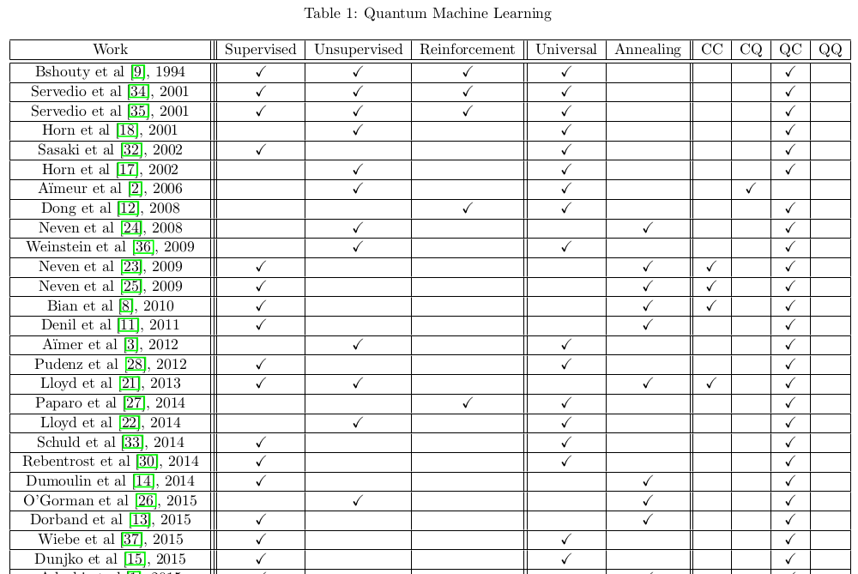
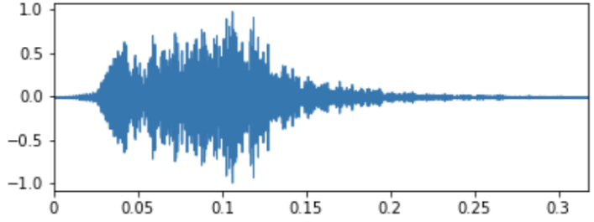
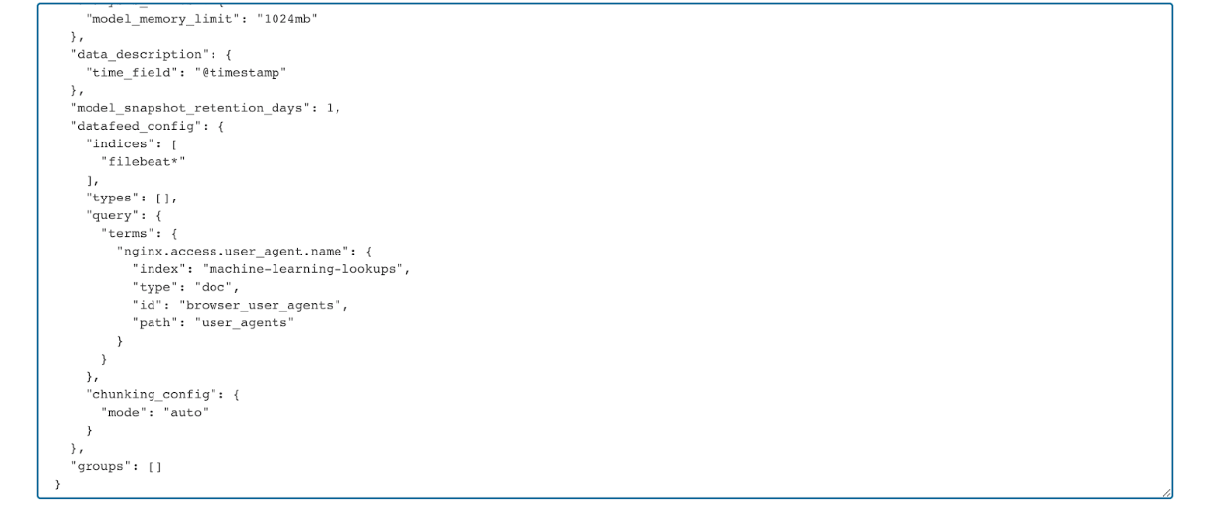
Data Engineering Terminology
Ways to organize data
Structured data: defined schema that is needed to interpret the data
Table of values such as a relational database table
Unstructured data: no defined schema or structural properties
PDFs, images, video, audio, logs, tweets
Semi-structured data: not relational, but has some organization
CSV, JSON, XML

Slide 6
Data Engineering Terminology
Data Lake vs Data Warehouse
Data Lake
Storage for large amounts of unstructured data from many sources/formats loaded into S3
No preprocessing, processed on export
Can run analytics from data lake
Data Warehouse
Aggregated data from many sources/formats into a warehouse
Data preprocessed before loading
Can run analytics from data warehouse

Slide 7
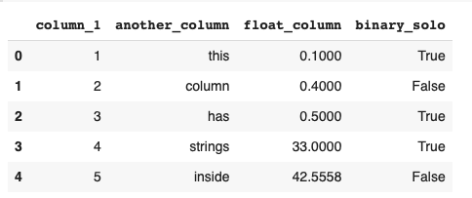
Data Engineering Terminology
Labeled Data vs Unlabeled Data
Labeled data
Has a target attribute
Unlabeled Data
No target attribute

Slide 8
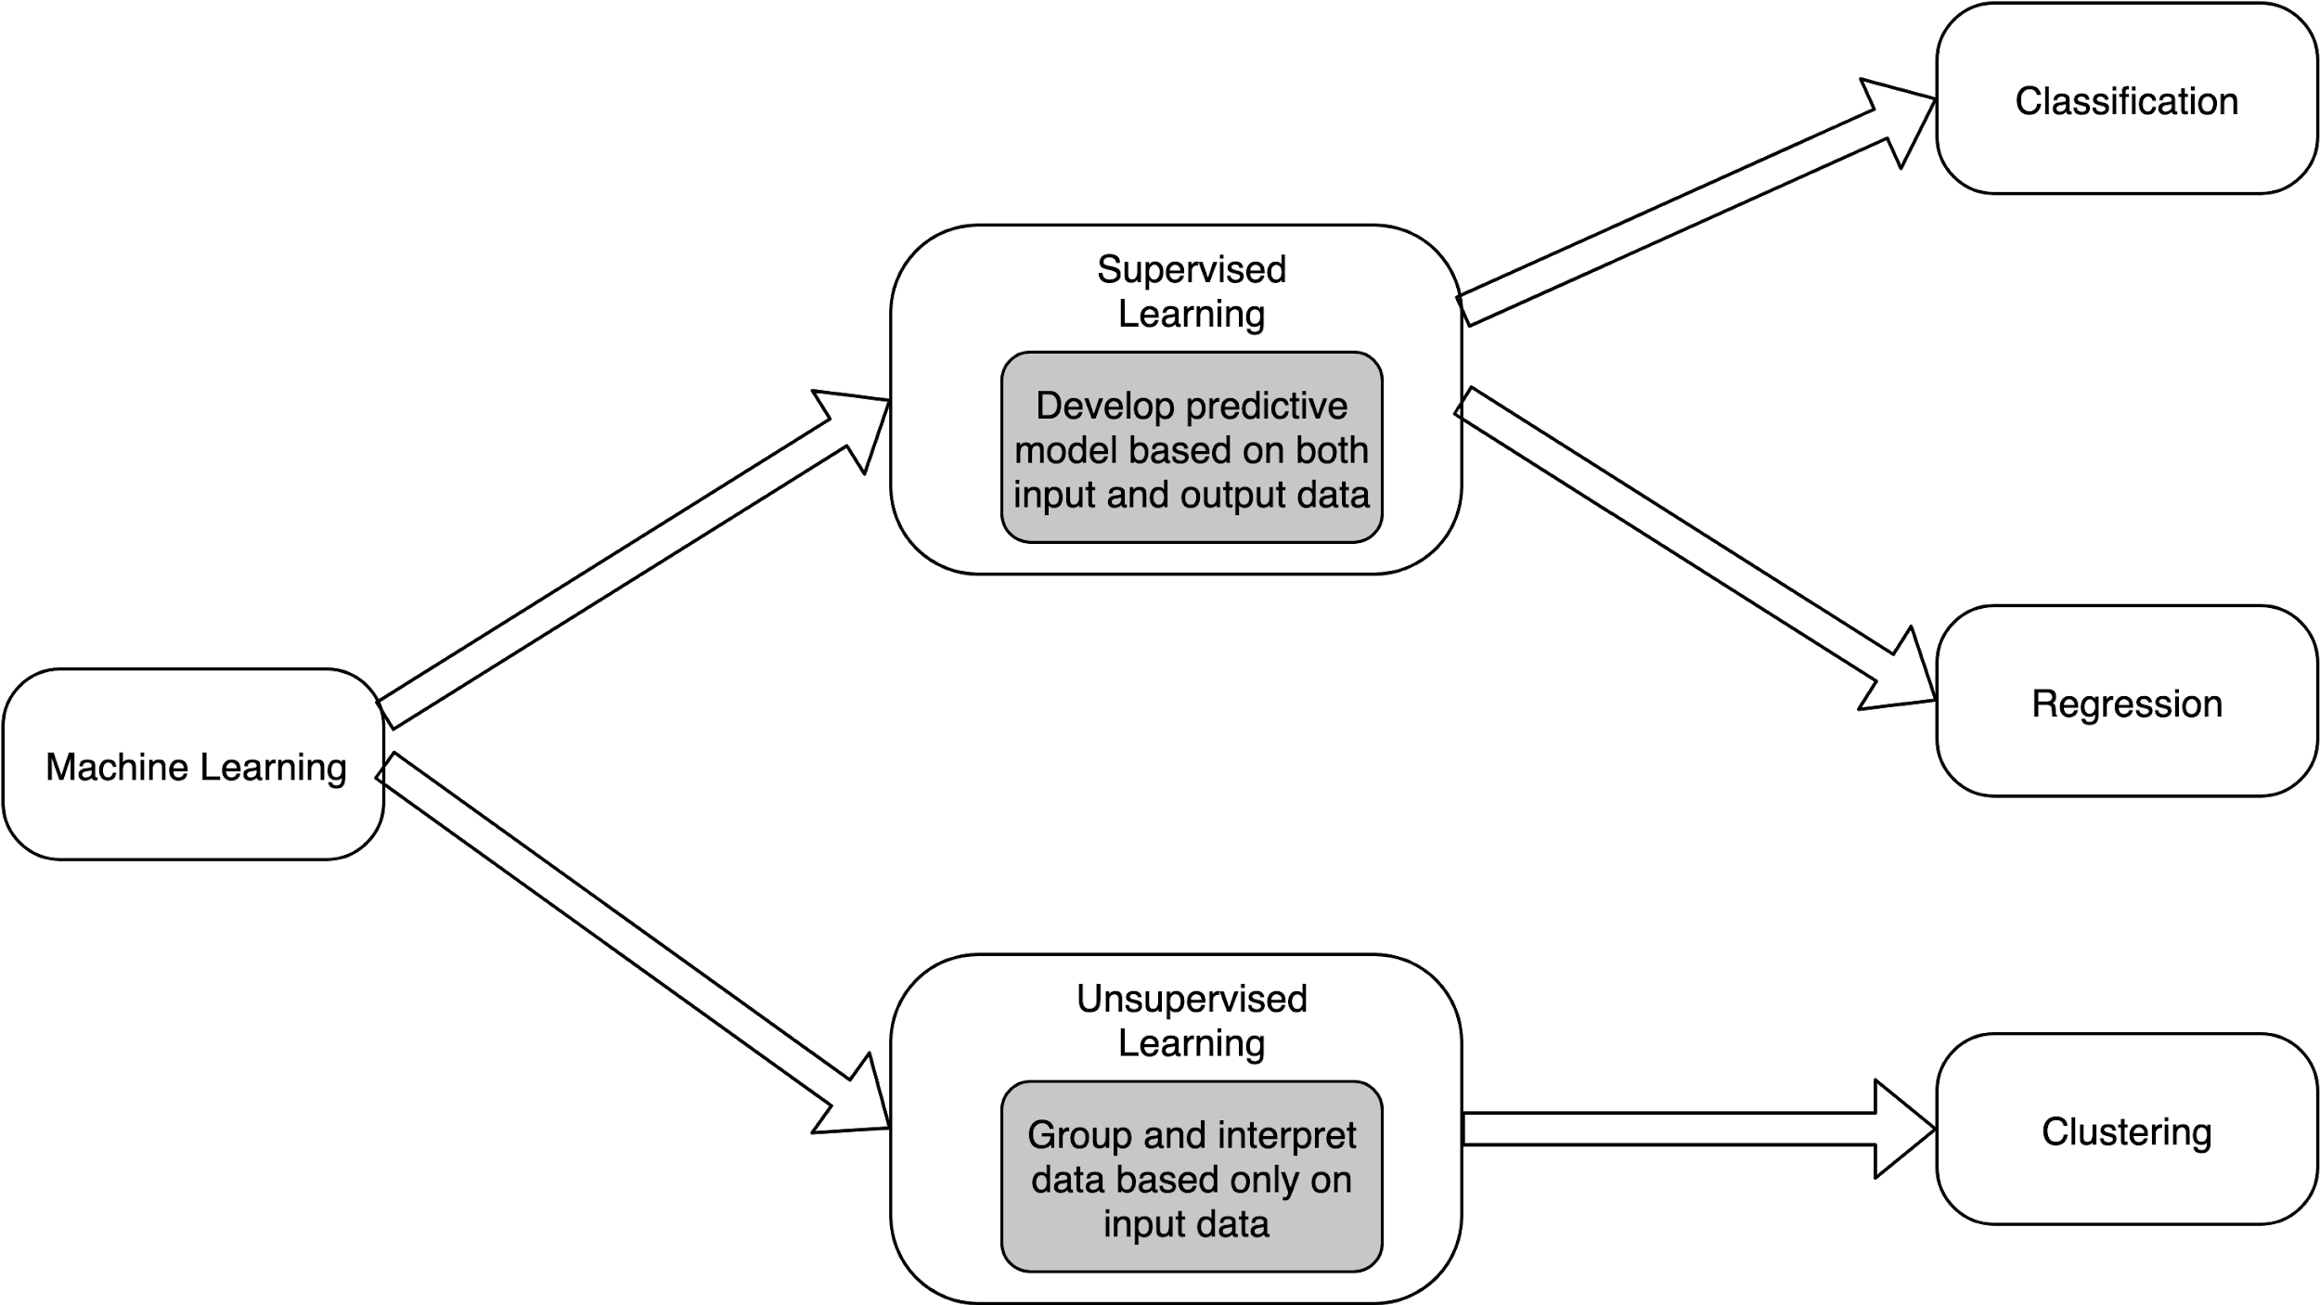
Data Engineering Terminology
Supervised Learning vs Unsupervised Learning
Supervised learning
Mostly used with labeled data
Unsupervised Learning
Mostly used with unlabeled data

Slide 9
Data Engineering Terminology
Categorical Features vs Continuous Features
Categorical features
Associated with a finite group
Qualitative
Discrete
Continuous features
Values that are expressed as a measurable number
Quantitative

Slide 10

Data Engineering Terminology
Corpus Data
Corpus data
Data collected from text
Used in Natural Language Processing (NLP)
Speech recognition, text-to-speech

Slide 11
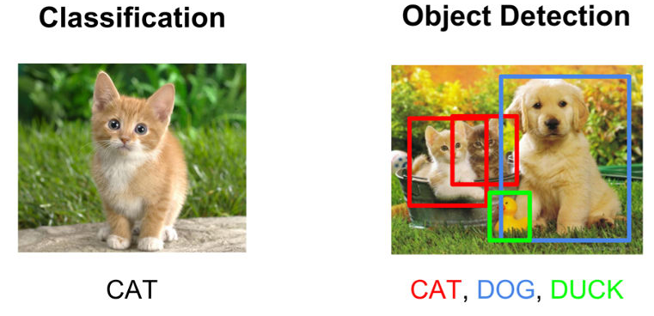
Data Engineering Terminology
Ground Truth Data
Ground truth data
Dataset that has observed or measured data that has been successfully labeled

